Slide 1


Name of Project
Waste Sorting Using Computer Vision
Poovarasan k
Subhash M
Varun P
Rakesh P
Tamileneyan M

Slide 2
Content
Abstract
Problem Statement
Objective
Data Collection and Preparation
Proposed Solution (Methodology)
Model Performance Evaluation
Screenshots / Demonstration (video)
Future Scope
Conclusion
Notes:
Abstract
Problem Statement (Clearly define the challenge)
Objective (State your project's goal)
Background and Research (Discuss existing solutions, trends, and gaps)
Data Collection and Preparation (Focus on data sources, cleaning, and augmentation)
Proposed Solution (Methodology)
Model Architecture (e.g., CNN, U-Net, YOLOv5)
Key Techniques (e.g., Transfer Learning, Image Augmentation)
Model Performance Evaluation
Metrics (Accuracy, Precision, Recall, IoU, etc.)
Graphs (Confusion Matrix, ROC Curve, etc.)
Screenshots / Demonstration (Visual proof of system functionality)
Future Scope (Improvements, scalability, and integration ideas)
Conclusion (Summarize results and impact)
Q&A Session

Slide 3
Abstract
Importance of efficient waste management for sustainability
Manual sorting is labor-intensive and error-prone
Computer vision and AI offer automated solutions
Focus: Classifying waste into plastic, glass, metal, and paper using image data

Slide 4
Problem Statement
Incorrect sorting reduces recycling efficiency
Manual processes are slow and inconsistent
Need for scalable, accurate automated sorting

Slide 5
Objective
Develop a computer vision model to classify waste types
Improve sorting accuracy and reduce operational costs
Increase recycling rates by reducing contamination

Slide 6
Data Collection and Preparation
Dataset: Labeled images of plastic, glass, metal, and paper waste
Preprocessing:
Image resizing
Normalization
Data augmentation (rotation, flipping)
Splitting: Train, validation, and test sets

Slide 7
Proposed Solution (Methodology)
Model Used: Convolutional Neural Network (CNN)
Steps:
Input image → convolution layers
Feature extraction
Flattening and classification
Tools & Frameworks: TensorFlow / Keras / PyTorch

Slide 8
Model Performance Evaluation
Accuracy: ~90% on test data
Confusion Matrix: Shows class-wise precision
Real-world impact:
25% improvement in sorting accuracy
15% reduction in labor costs
Higher recycling rate

Slide 9
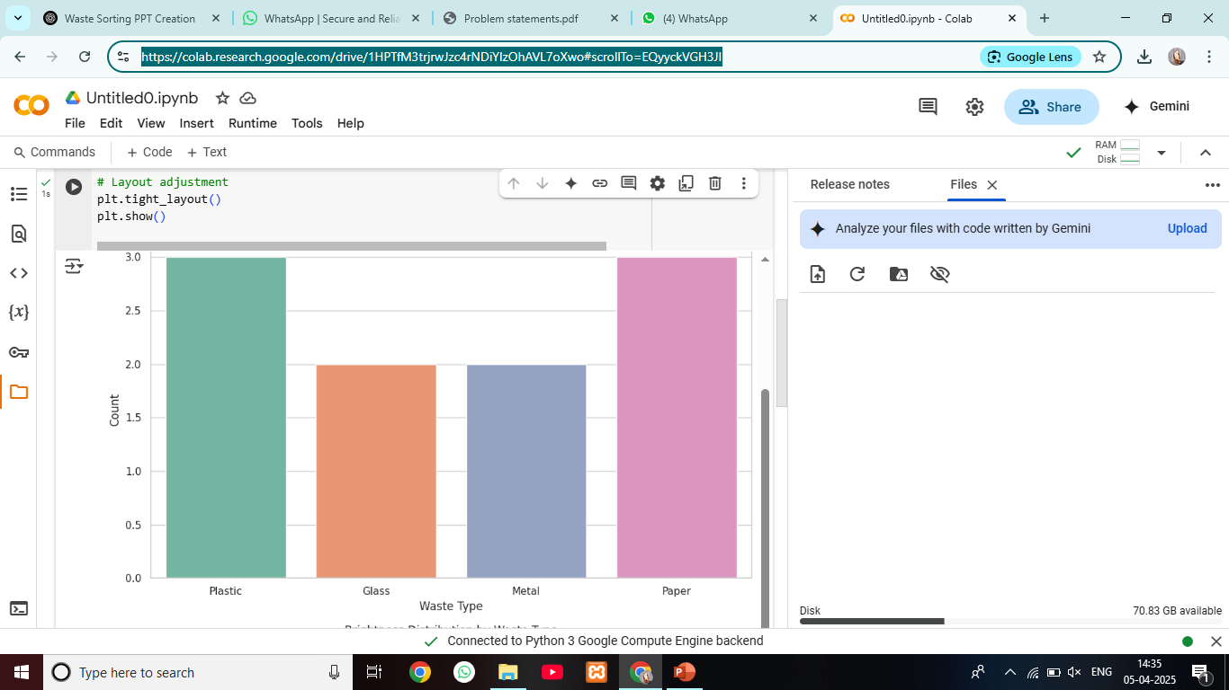
Screenshots / Demonstration (video)
Colab link:https://colab.research.google.com/drive/1HPTfM3trjrwJzc4rNDiYIzOhAVL7oXwo#scrollTo=EQyyckVGH3JI
Githup Link: https://github.com/Poovarasan123456789/poovarasan/upload/main

Slide 10
Future Scope
Integrate IoT for real-time tracking
Expand dataset with more diverse waste categories
Deploy model on embedded devices for mobile sorting units
Use robotics for physical separation post-classification

Slide 11
Conclusion
AI can revolutionize waste management
Computer vision offers accurate, scalable solutions
Significant environmental and economic impact
Paving the way for smarter, greener cities

Slide 12
Question & Answer
1. How can CNNs be applied to classify images of waste accurately?
CNNs automatically learn features like shape, color, and texture from waste images. They use these patterns to classify images into categories like plastic, glass, metal, or paper with high accuracy.
2. What preprocessing steps are required to enhance the image quality for the model?
2. Resize images, normalize pixel values, apply data augmentation (like flipping or rotation), and convert labels into numerical format to prepare the data for training a CNN.

